Slide 1
Chapter 02 Flowchart of Panorama Stitching
(Theme 1)
Prof. Lin ZHANG
School of Computer Science and Technology
Tongji University

Slide 2
Problem definition of panorama stitching
Panorama stitching is the process of combining multiple photographic images with overlapping fields of view to produce a segmented panorama or high-resolution image
Let’s see an example

Slide 3

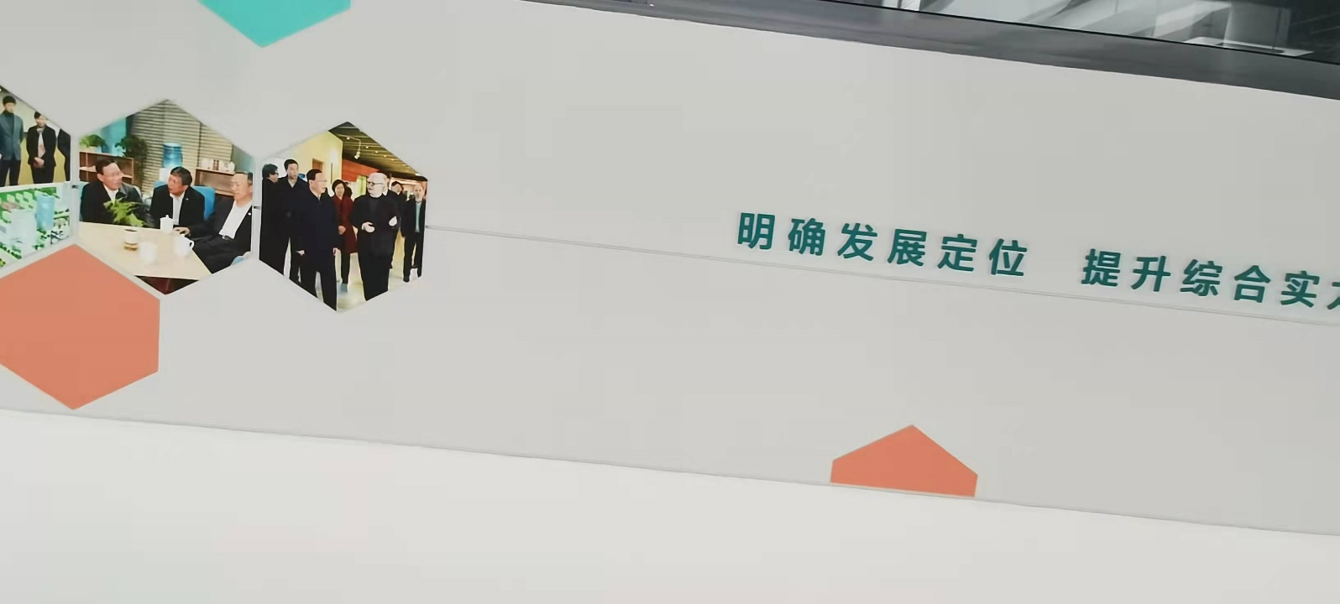
Problem definition of panorama stitching

Slide 4
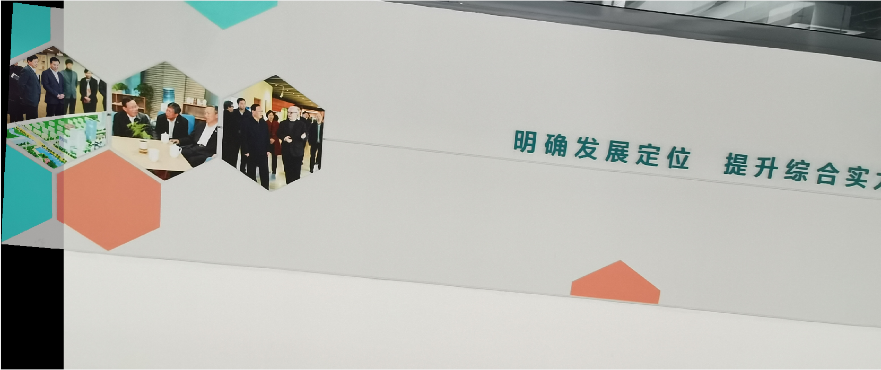
Panorama stitching result using the techniques introduced in this course

Slide 5
Problem definition of panorama stitching
In this course, when we combine two images I₁ and I₂, actually we have some assumptions about I₁ and I₂ to make sure that they can be stitched theoretically
I₁ and I₂ should have common-view areas
The physical planes they imaged are coplanar
The two cameras do not have lens distortions
Implying that the two images can be linked via a linear geometric transformation, i.e.,
, , if x and x’ is a correspondence pair, then,
So the core problem for panorama stitching is to find such an H

Slide 6


How to achieve panorama stitching?
A toy example
Can you imagine how to stitch I₁ and I₂ together manually?
The physical scene
By computerizing the manual process, we can get the algorithms to fulfill this task
imaging

Slide 7
How to achieve panorama stitching?
Identify the key points on I₁ and I₂
Build descriptors for all the key points
Matching key points to get the correspondence pairs
Based on S, solve H that can (roughly) map each x_{i} to . At this step, we need to consider the imperfectness of S, i.e., some correspondence pairs in S may be outliers
Apply H to I₁ to align it with I₂; this step needs to use image interpolation techniques
where means that the point x_{i} from I₁ and the point from I₂ matches, and p is the number of correspondence pairs

Slide 8
Contents of this theme
Chapter 3 will introduce details about linear geometric transformation
Chapter 4 will discuss key point detection and matching
To solve H from the correspondence pairs is a linear least-squares problem, which will be discussed in Chapter 5
RANSAC is a universal framework to estimate model from observations with outliers, which will be introduced in Chapter 6

Slide 9
Contents of this theme
应用
全景拼接
图像配准
相机位姿估计
视觉里程计
技术
图像间特征点检测与匹配
平面间单应变换估计
Harris角点检测
SIFT描述子
FAST特征点
描述子匹配
BRIEF描述子
算法
双线性插值
尺度不变点检测
高斯差分尺度空间
随机抽样一致
线性几何变换
几何变换群
特殊欧氏群
特殊正交群
特征值分解
线性方程组的解
拉格朗日乘子法
数学
泰勒展开
行列式与迹
奇异值分解
曲率
齐次线性最小二乘问题及其求解
非齐次线性最小二乘问题及其求解
凸函数

Slide 10


